Slide 1
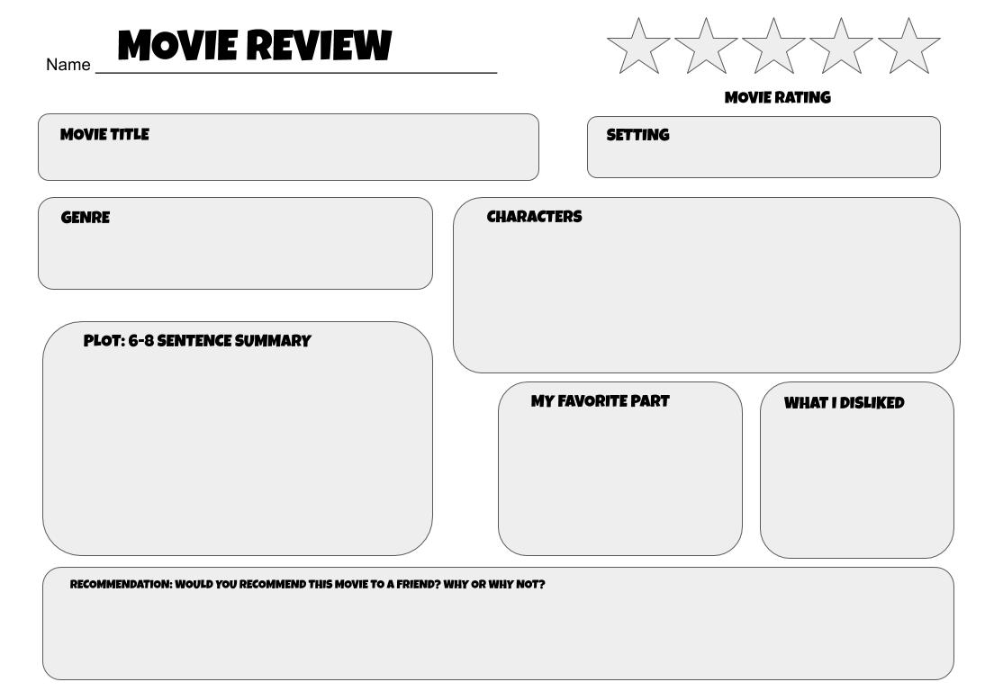
Click on stars and choose “fill color” (paint can) from the toolbar to change color.
Type Here
Type Here
Type Here
Type Here
Type Here
Type Here
Type Here
Type Here

